Slide 1

US Rental Market Analysis
By:- Akash Yadav & Aryan Varmora

Slide 2

Introduction
Data: Apartment rental pricing dataset (Source: UCI)
Background of the data:
This dataset contains around 100,000 observations with comprehensive details about US apartment rentals. It includes attributes like amenities, bedrooms, pricing, location, and more. Partially cleaned, it's a valuable resource for real estate research, enabling various data analysis tasks and insights into US apartment rental dynamics. Ideal for further analysis.

Slide 3

Overview Of the Dataset
Dataset Size: Total Records: 99105
Columns: Total: 23 features
Includes detailed information on pricing, amenities, location, number of bedrooms and bathrooms, square footage, pet policies, and more..
Data Diversity:
The dataset features a broad spectrum of apartment rentals across various regions in the US. It reflects diverse aspects such as rental prices, apartment features, and geographical locations, providing a holistic view of the apartment rental market.
Relevance:
This dataset's extensive coverage and depth provide essential insights into market dynamics, pricing strategies, and consumer preferences, enabling a detailed analysis of real estate rental trends and strategic decision-making.
Data Source : https://archive.ics.uci.edu/dataset/555/apartment+for+rent+classified

Slide 4
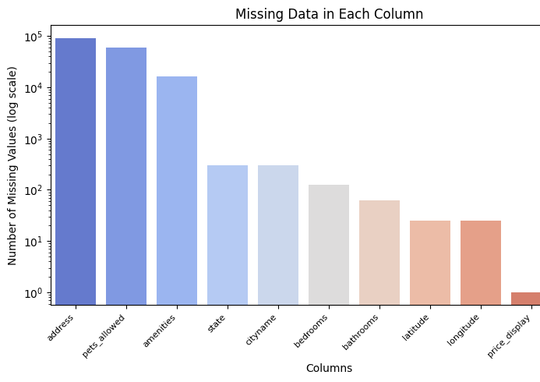
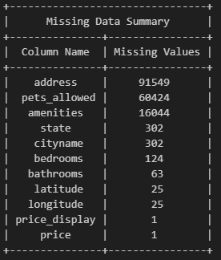
Pre-Processing Dataset

Slide 5
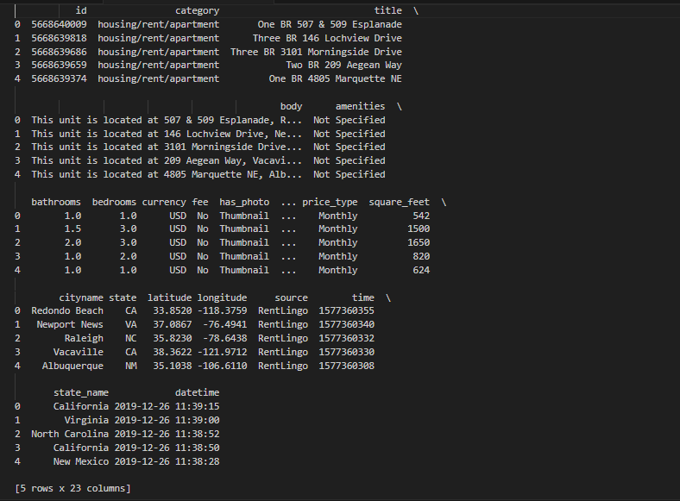
Cleaned Dataset

Slide 6
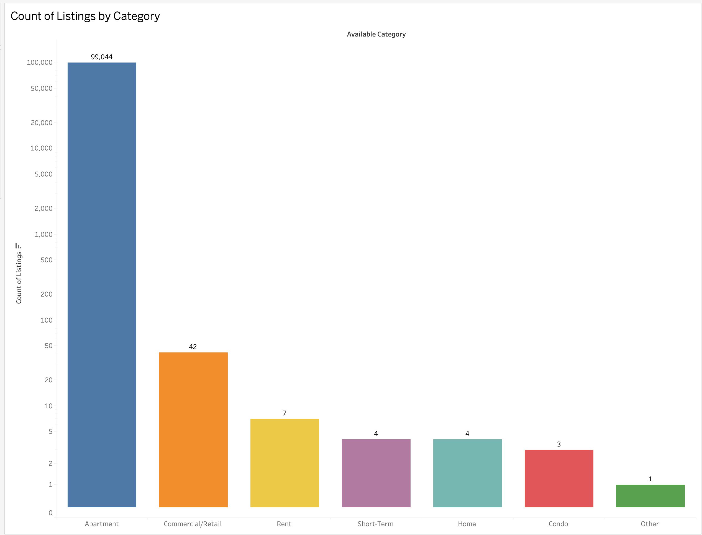
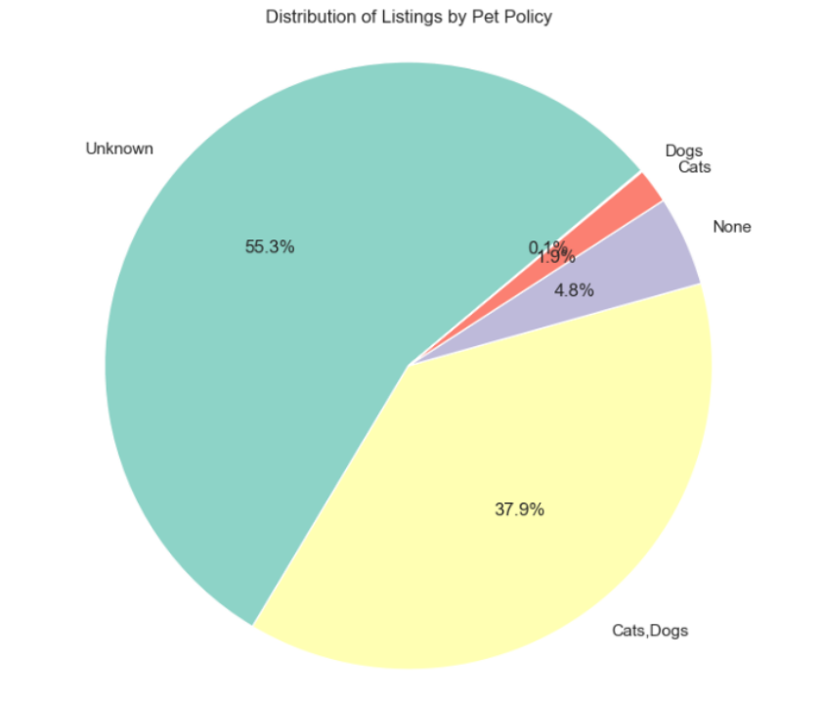
Focus Of Dataset

Slide 7
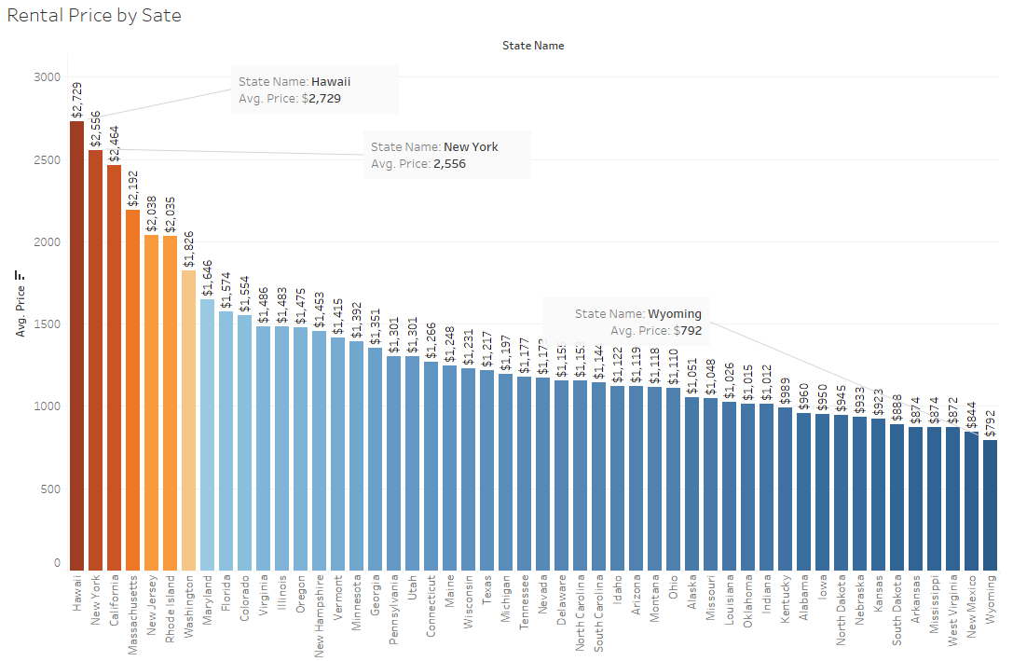
Rental Price Across States

Slide 8
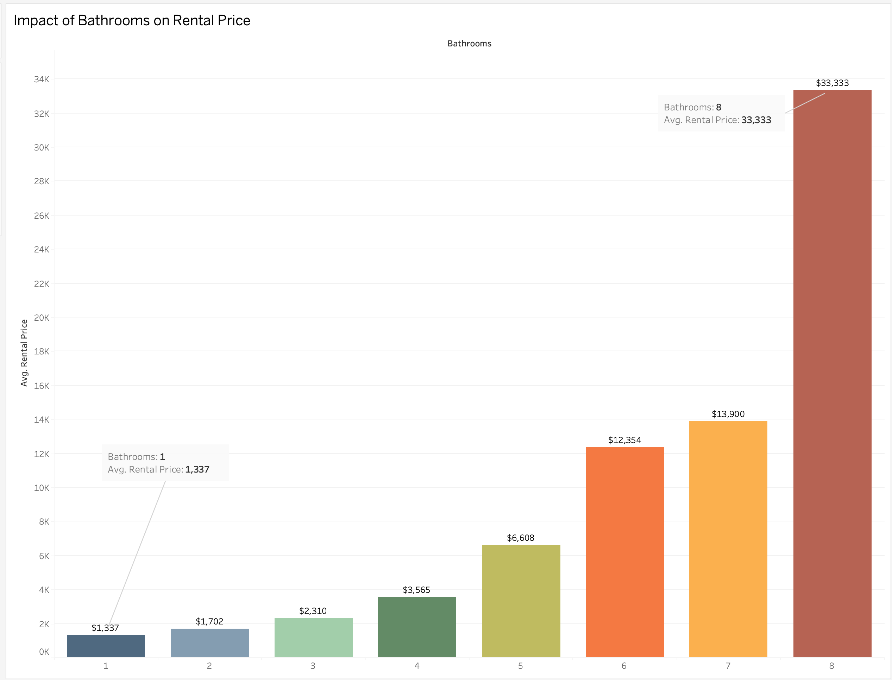
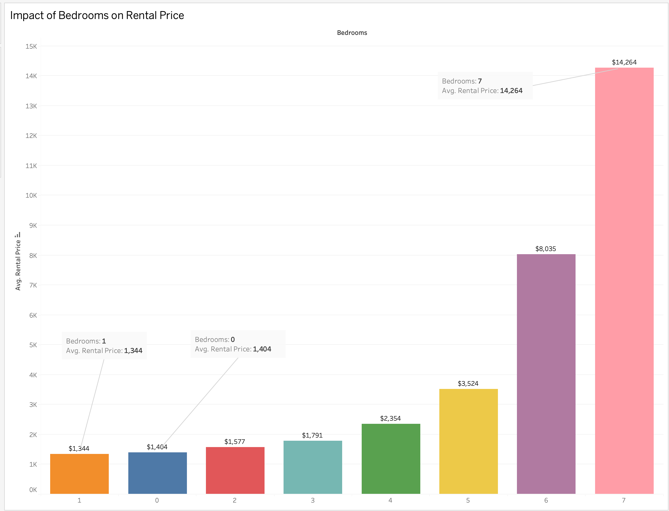
Bedrooms & Bathrooms
For both bathrooms and bedrooms, as their number increases, so does the spread and range of rental prices, which is evident from the vertical dispersion of points.
⁠A greater number of bathrooms correlates with a higher rental price, as shown by the more pronounced spread upwards in the rental price axis.
⁠⁠Similarly, the number of bedrooms also shows a correlation with rental prices, where apartments with more bedrooms tend to have a higher price range.
There are a few outliers, particularly in properties with a higher number of bathrooms, indicating some rentals are priced much higher than the majority within the same category.

Slide 9

Now let’s go to Tableau to “Feel The Visualization”

Slide 10
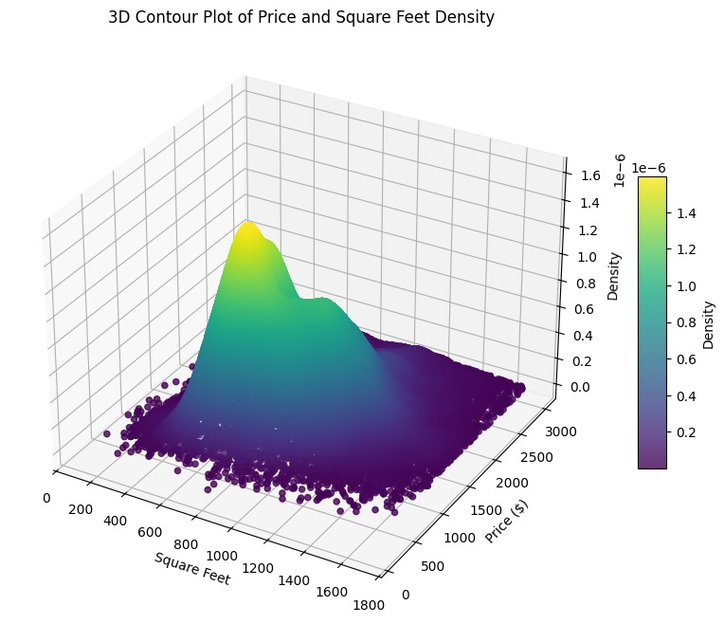
3D Visualization
The peak density area illustrates the most common combination of price and size,which seems to be at the lower end of both dimensions.
Higher price levels show less density, confirming that higher-priced apartments are less common.
The plot also shows that the density does not increase proportionally with size and price, suggesting that other factors may influence the relationship between apartment size and price.

Slide 11
Conclusion
Market Profiles: Most apartments fall in the modest size and price range, with fewer luxury options.
Location Costs: Coastal and metropolitan areas typically command higher rental prices.
Timing Matters: Rental prices fluctuate seasonally, absent a consistent long-term trend.
Feature Premiums: Additional bathrooms slightly elevate rental prices, amidst other influencing factors.
Size Matters: There’s a general, though variable, trend of larger apartments attracting higher prices.
Market Dynamics: Visual data analysis reveals intricate patterns of how features and geography drive rental pricing.

Slide 12


